Slide 1
Top tips and tricks for Custom Connectors 🧙‍♂️

Slide 2
Agenda
Top tips and tricks for Custom Connectors
Get ready for Copilot
Certification
Lab 04
Q & A

Slide 3
Top tips and tricks for Custom Connectors

Slide 4
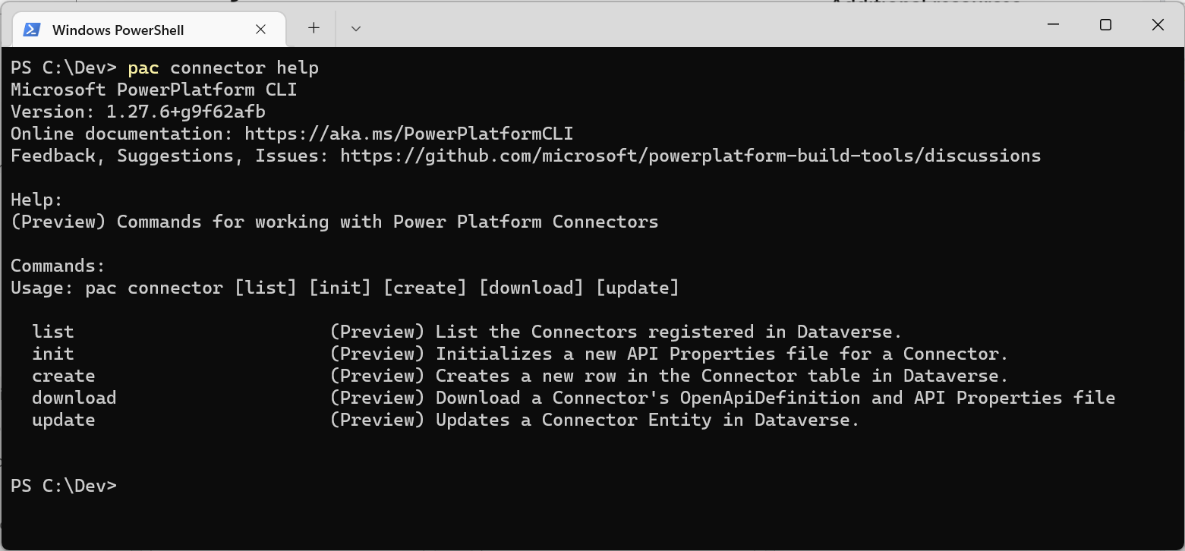
How to get started – Use Power Platform CLI for ALM

Slide 5
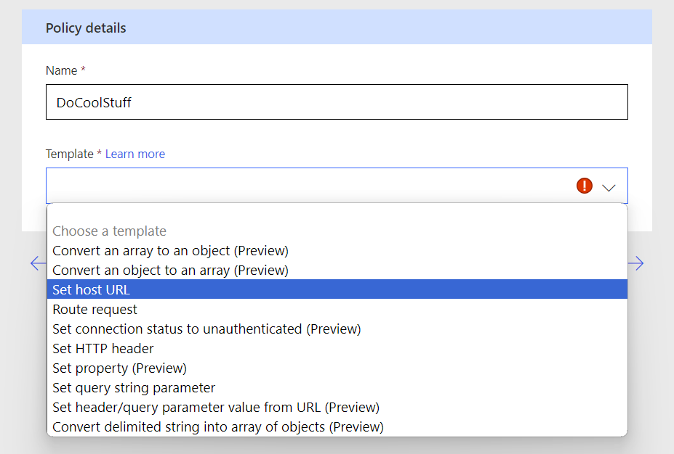
DON’T HARDCODE – Use policies

Slide 6
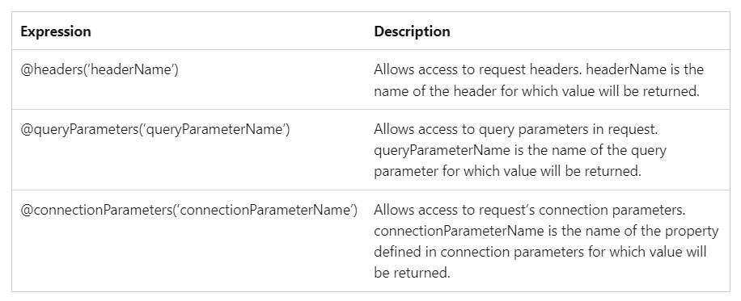
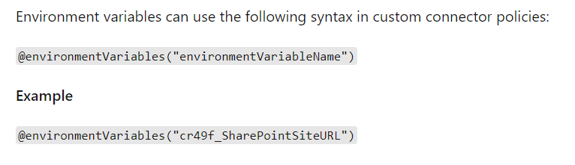
DON’T HARDCODE – Use policies – Variables on different levels
Query Parameter -> setting per action ("per flow")
Connection Parameter -> setting per connection ("per user")
Environment Variable -> setting per environment ("global")

Slide 7
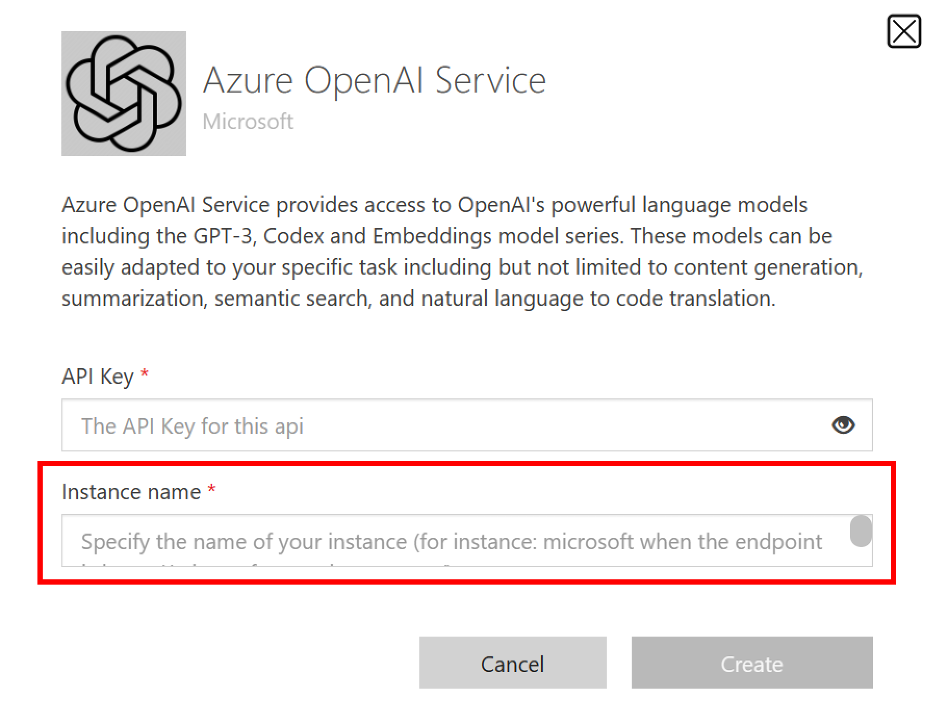
Connection parameters

Slide 8
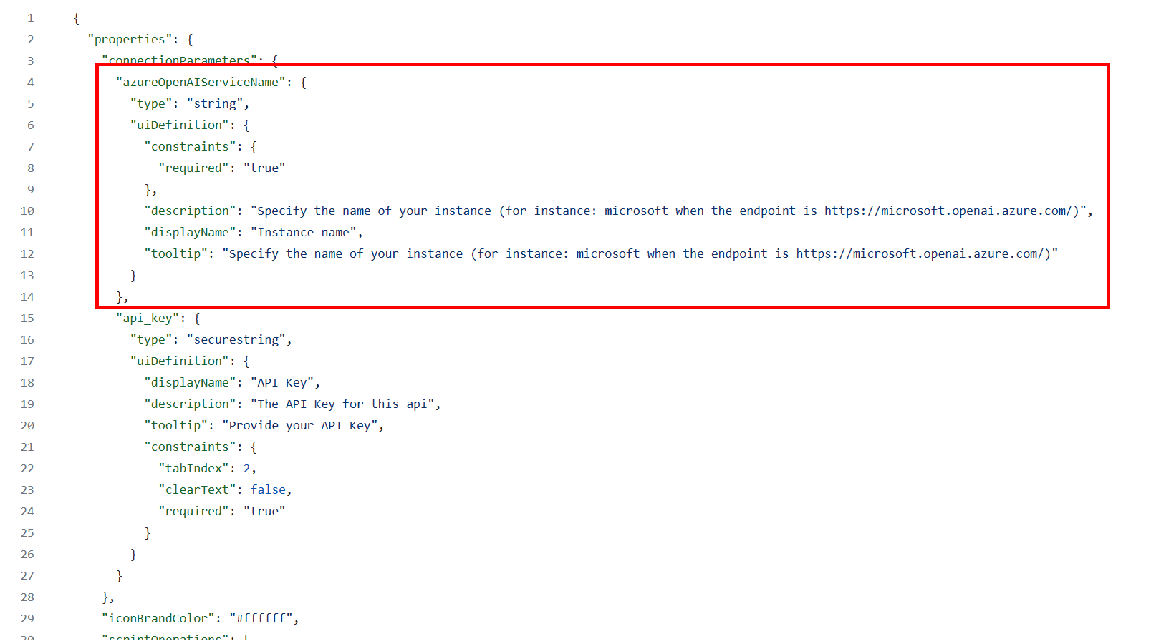
Connection parameters

Slide 9
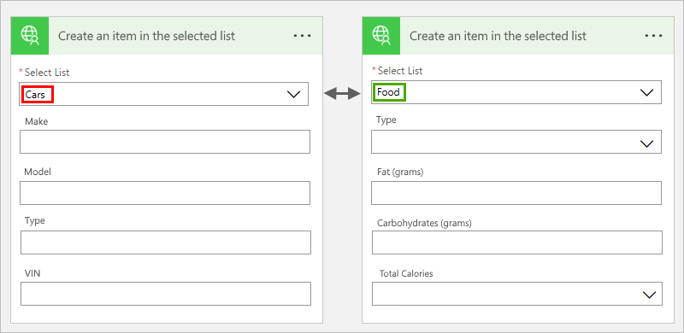
Use x-ms-extensions (dynamic schema)

Slide 10
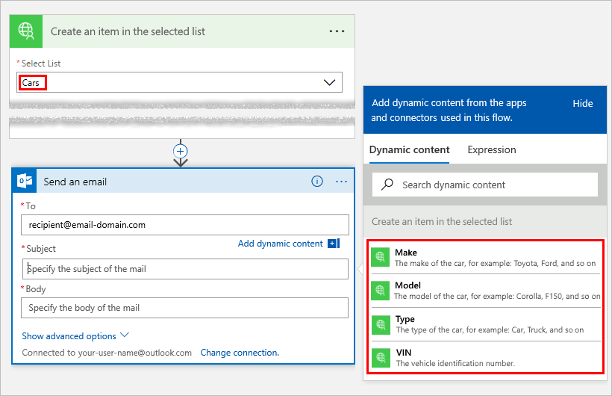
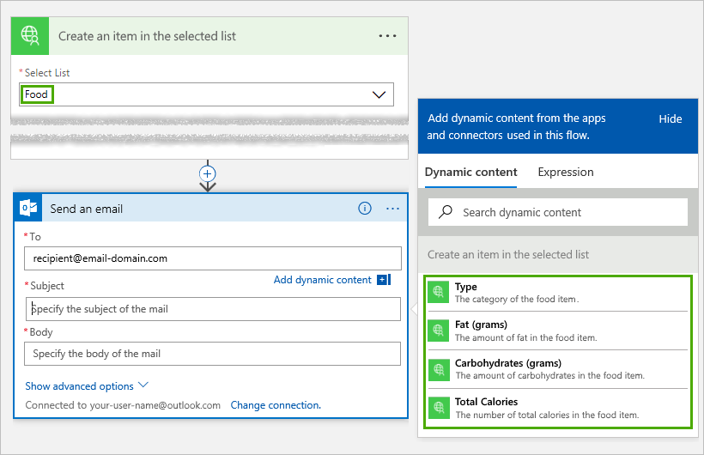
Use x-ms-extensions (dynamic schema)

Slide 11
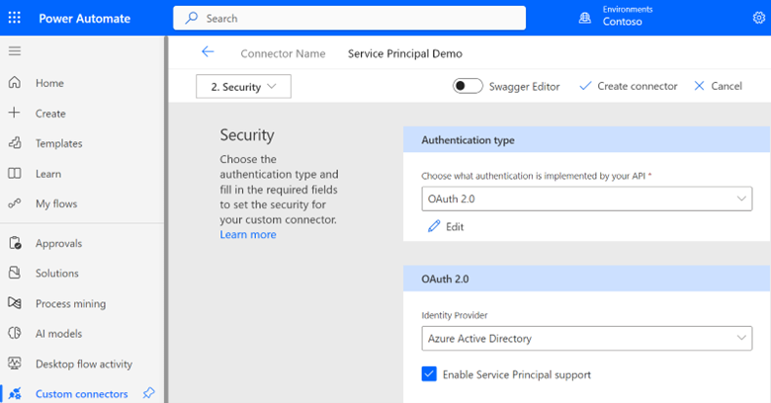
Service Principal Support
Lab available at aka.ms/cc/spn-lab

Slide 12
Get ready for Copilot

Slide 13
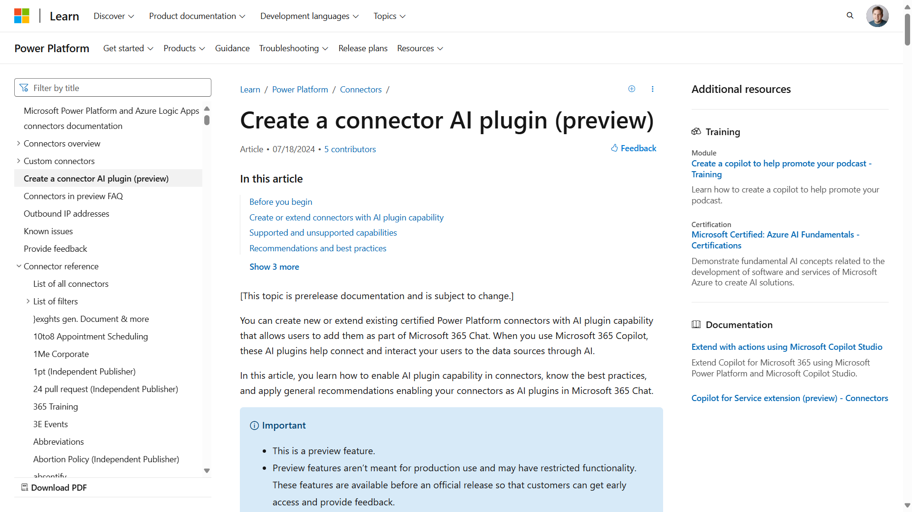
Demo: Create a connector AI plugin
https://aka.ms/cc/create-ai-plugin
Notes:
https://aka.ms/cc/create-ai-plugin

Slide 14
Certification

Slide 15














Certification
Connector
Type
Custom Connector
Certified Connector
Independent Publisher Connector
API
Availability
Public or private
Public
Public
Service
Owner
Connector developer or someone else
Connector developer
Someone else
Audience
Internal
Everyone
Everyone

Slide 16
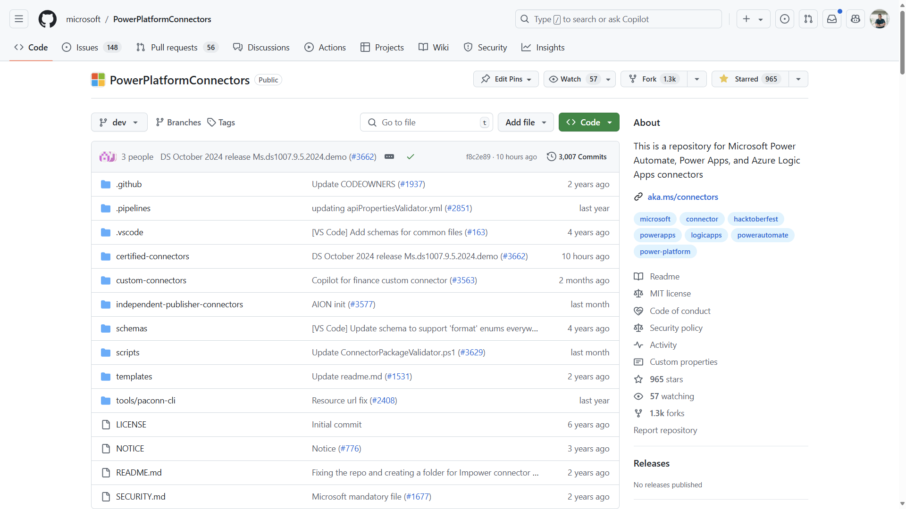
Custom Connector Resources: GitHub
https://aka.ms/cc/github

Slide 17

DEMO TIME!

Slide 18
Lab 04 – Update a connector for Copilot

Slide 19
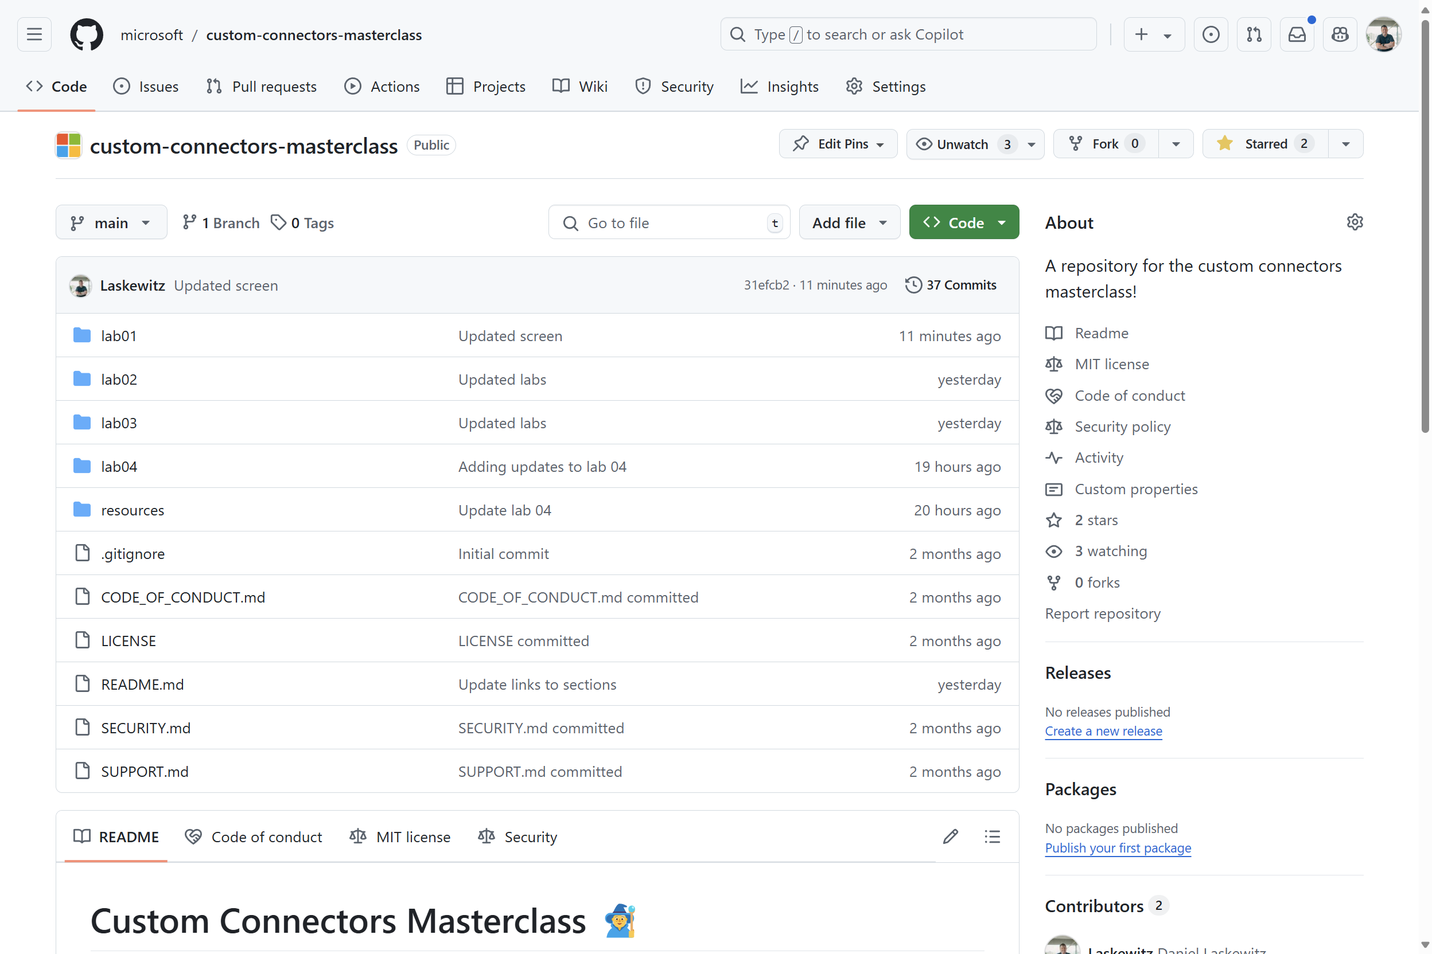
Lab environment
https://aka.ms/custom-connector-masterclass

Slide 20
Lab 04 – Top tips and tricks for Custom Connectors
Import a connector as a OpenAPI v2 (swagger) file
Learn how to enable a connector as an AI plugin
Test your connector with the local debugging tool

Slide 21
Lab 04 – Wrap up
Questions?
Ideas?
Comments?

Slide 22
Notes:
Please scan the QR code in the room to give feedback.
Room responsible will support us with a QR code – or use the App to find the session!

Slide 24
Thank You!

